Slide 1
Shiksha Sanskar Swavalamban
Shiksha Sopan
An Initiative of IIT Community for social upliftment
Reg. Office: 391, Nankari, IIT, Kanpur 208016, PAN : AAFTS9743R
Newsletter July 2021
Dear Readers, Greeting from the Shiksha Sopan family. We hope you and your family are safe from this pandemic.
Central programs
Einstein Nobel Prize Centenary Year Celebration
(ENOPCYC 2021)
Basic Teachers Workshop, Kanpur, Blocks
Shiksha Sopan and SGM-IAPT Anveshika organized this ENOPCYC session especially for Basic Teachers of Kanpur. We worked very closely with Dr. Pawan Kumar Tiwari, Basic Shiksha Adhikari (BSA) Kanpur & Mr. Devendra Patel, Khand Shiksha Adhikari, Chaubepur block for conducting these sessions. In each session around 300 teachers were participated. The online session was conducted on Zoom. Mr. Govind Lakhotiya, Director, Bajaj Science Center, Wardha provided the technical support. The sessions were conducted between 11 June to 15 June 2021 from 10.30 AM to 11.30 AM.
The workshop was inaugurated on 11th June after that Dr. Pawan Kumar Tiwari gave a welcoming speech and spoke about the work which is done by Verma sir for the society. Mr. Devendra Patel Ji and Mr. Umakant Ji were also present in the session. Mr. Amit Kumar Bajpai hosted the session.
The first-day session was taken by Dr. H. C. Verma sir. He spoke about Albert Einstein with the help of a short video created by Mr. Abhishek Dass Ji. He also explained about electroscope, photoelectric effect, etc without using any equations and formulas. Other sessions were also organized for other blocks, the date wise and block-wise events listed below.
S.No | Date of the workshop | Name of the blocks | No of participants | Name of the resource Person
1 | 11 June 2021 | Bilhaour+Shivrajpur | 250 | Dr. H. C. Verma, Kanpur
2 | 12 June 2021 | Kakvan + Kalyanpur | 270 | Mr. Rohit Sharma, Dehradun
3 | 13 June 2021 | Nagarkshetra+Patara | 230 | Mr. Govind Lakhotiya, Wardha
4 | 14 June 2021 | Sarsaul + Bidhanu | 255 | Dr. H.C. Verma, Kanpur
5 | 15 June 2021 | Ghatampur + Bheetergaoun | 170 | Mr. Rohit Sharma, Dehradun
Notes:
07/06/12
1

Slide 2
Basic Teachers Workshop, Kanpur, Blocks
In June from 22nd to 24th June 2021, we have conducted three days’ workshop for the teachers and students of Orai, Jalaun. The first-day session was taken by Mr. Yogesh K Jha and demonstrated a variety of experiments like charging balloons, dancing straws, electroscope, induction, and photoelectric effect to the students. This session was for some selected classes 6 to 8th. Students were very happy to see these experiments and they enjoyed them a lot. They have also cleared their doubts by asking the questions after the demonstration got over. The reply to the queries was given by Mr. Yogesh K Jha and Mr. Amit K Bajpai.
On 23rd June 2021 session was arranged for the teachers. In this session, Dr. H. C. Verma sir was the resource person. Mr. Bhagwat Patel, District Inspector of School (DIOS) Orai, Jalaun district welcomed Dr. H C Verma and his team. Dr. Verma took a wonderful and motivational session in which he discussed many experiments.
The third-day session was taken by Mr. Sanjay Kumar Singh, PGT teacher ETAWA who is closely related to the First Sunday Club activity of SGM-IAPT Anveshika. He talked about Photoelectric Effect and explained it very well. In this session, participants were from Class 9 to 12 students.
S.No. | Date of the workshop | Students/Teachers | No. of participants | Name of the resource Person
1 | 22 June 2021 | Students class 6 to 8 | 44 | Mr. Yogesh Kumar Jha, Kanpur
2 | 23 June 2021 | Teachers | 80 | Dr. H. C. Verma
3 | 24 June 2021 | Students class 9 to 12 | 63 | Mr. Sanjay Kumar Singh, Etawa
 |  | Total | 187
State level two days’ workshop
Regional Council -4 (RC-4) Uttar Pradesh, Indian Association of Physics Teachers (IAPT) in association with Shiksha Sopan conducted a two days’ workshop from 7 and 8 June. Mr. Amit Kumar Bajpai, secretary, Shiksha Sopan coordinated the workshop along with Dr. Rajesh K Dwivedi, President, RC-4. Approx 4800 teachers and students were registered for this workshop. The first session was held on 7th June, in which around 600 participants joined the session.
Dr. Verma took the session where he discussed the Photoelectric effect. He explained the theory of electroscope, experiments of Milikan and Photons.
The second session was an experimental demonstration session hosted by Amit K Bajpai. Mr. Bajpai and Mr. Mohit Kumar who came from Auraiya showed a very simple experiment related to the electric field and magnetic field. Mr. Ramendra Kushwaha one of the resource person’s demonstrated experiment related to Magnetism. At last Dr. Sunder Singh, Secretary, UP RC-4 gave a vote of thanks to the resource persons as well as participants. He showed his gratitude toward Verma sir. Workshop at PSIT, Kanpur

Slide 3
One of the renowned Eng. College Pranveer Singh Institute of Technology (PSIT) conducted a one-day interaction session with their B. Tech students on 21st June from 11.00 AM to 12.30 PM. Prof. H. C. Verma Sir was the main speaker of the session. Dr. Urvashi Srivastava, Faculty PSIT coordinated the whole event.
Around 300 students have attended the session. Mr. Amit Kumar Bajpai and Mr. Ranjit Kumar assisted Verma sir during the demonstration. Dr. Verma demonstrated simple experiments and related to Maxwell’s equation. He showed wonderful diffraction and interference pattern through a green laser torch on the screen and asked the students about the slit. He asked which type of slits he is using to show those types of patterns. After the demonstration session students were very curious to ask the questions from Verma sir. Other sessions for ENOPCYC
S.No. | Date of the workshop | Students/ Teachers | School | No of participants | Name of the resource Person
1 | 5 June 2021 | Students (class 6-8) | Opportunity School, IITK | 25 | Mr. Yogesh K. Jha
2 | 5 June 2021 | Students (class 9-12) | Mixed school of Lucknow | 27 | Mr.Mineesh Gulati
3 | 6 June 2021 | Students (class 6-8) | Opportunity School, IITK | 25 | Mr. Yogesh K. Jha
4 | 9 June 2021 | Students (class 6–8) | Katyayan School | 30 | Mr. Yogesh K. Jha
5 | 10 June 2021 | Students (Class 9 to 12) | Katyayan School | 27 | Mr. Sanjay K Singh
6 | 13 June 2021 | Students (Class 9 to 12) | SN Sen Balika Intermediate College | 44 | Mrs. Smita Fangariya, Noida
First Sunday Club (FSC)
First Sunday of every month, SGM-IAPT Anveshika conducted a First Sunday Club activity as you read in an earlier newsletter. On 6th June 2021 from 10.00 AM to 12.00 noon, we called an FSC activity online on zoom. Because this FSC was online so we invited some teachers from other states who actively participated in discussions and activities. All the teachers were very excited for the Sunday club, around 44 teachers turned up on zoom.

Slide 4
Mr. Amit K Bajpai, Coordinator, SGM-IAPT Anveshika welcomed all teachers and invited them to the questions. After that, the activities go started. There were many questions asked by teachers and did discussion over that but before the Q/A started resource person of this session through a question “can we see any written object in water from naked eyes, without using anything”.
We had also asked them to keep some items like one bucket full of water, one leaf of a tree, and a pen then asked to write something on a leaf, like NANI (National Anveshika Network of India) or whatever you want, some of the teachers wrote HCV on the leaf. Then put the leaf in the bottom of the bucket inside the water using some weights after that these participants closed their eyes and put their heads inside the water then open their eyes inside the water, it was a little tricky but easily you could open the eyes, see the name which was written on the leaf, it was very difficult to identify what is written accurately. The words became a blur.
The discussion went on and concluded that the refractive indices of water are 1.33 and cornea is about 1.376. Rays pass from the cornea into the watery fluid known as the aqueous humor which has an index of refraction of about 1.336, so there is no refraction taking place. It is like the same medium and no image creates on the retina of the eye. Mr. Bajpai again did one thing to support these discussions, he covered his face, eyes using a transparent polythene bag and put his head inside the water, opened his eyes, and see the name on the leaf, he can and read name was written on the leaf. Due to this little air trapped inside the polythene and there was a changed in refractive indices and you can easily see the image.
Vigyan Jyoti
Vigyan Jyoti is scheme of Department of Science of Technology, India to promote specially girls to do better in the field of Science, Technology, Engineering and Mathematics (STEM). Vigyan Jyoti in collaboration with Jawahar Navodaya Vidyalaya, Haridwar, Uttrakhand invited Prof H. C. Verma for one hour session on 29th June from 4 PM to 5PM for class 11 and 12 students. Prof. H. C. Verma sir interacted with the students online from Sopan Ashram. Verma sir demonstrated Ohm’s law, Cartesian diver and other experiments. First he showed one wall clock to the students. Second hand (needle) of the clock was moving with continuous smooth velocity and he asked the question “Is needle has periodic motion?” Students took time and answered the question, yes. In next step Verma sir told the radius of the needle by measuring it from the scale and asked about Speed and acceleration, direction of acceleration, time period, frequency etc to the students. With the help of regular wall clock he covered many topics of Physics. Students enjoyed the session and thanks to Verma sir for this type of session which was very helpful to understand Physics from daily life.

Slide 5
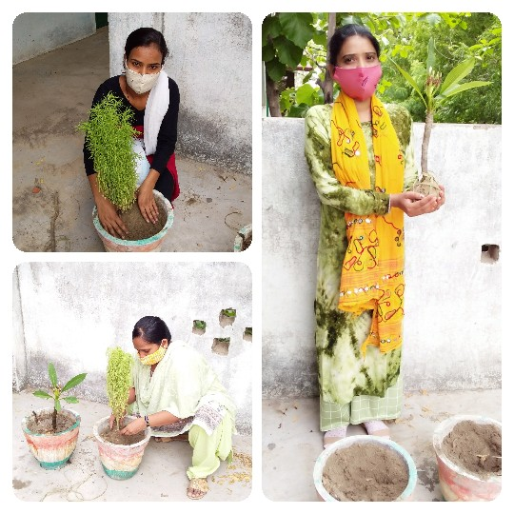
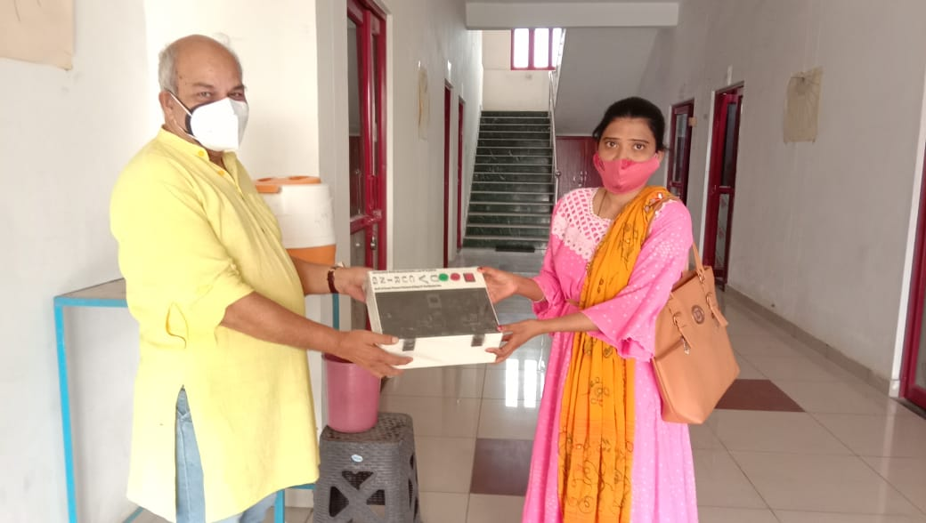
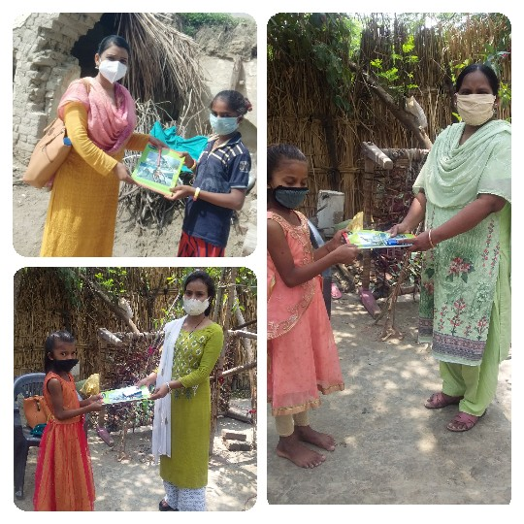
Sopan Anaupacharik Shikshan Kendra (SASK)
World Environment Day
As we know that a healthy environment plays an important role in everyone’s life. A clean and green environment gives positive vibes to the people. To make a healthy environment we need to plant more and more trees in our nearby places. 5th June of every year whole world celebrates as World Environment Day. On this day every people should plant trees. SASK also celebrated the same on the 5th of June. Volunteers of SASK planted trees in SASK premises. Coordinator Miss Seema Verma gave a speech to the students of SASK and told them about the importance of trees in our life. She also told that we should not forget the tree after the plantation, we should water the plant on daily basis and take care of the same.
Gifted the UV sanitizer box
In June month, Shiksha Sopan gifted the UV sanitizer to their volunteers. Seema Verma also received the same through our chief functionary Dr. H C Verma. Through this box, one can sanitize its currency, mobile phone, watch, etc by putting it in the box.
Distribution of stationary to the needy children
In June month volunteers of SASK visited every children’s house of SASK. Where they got interacted with their parents and were asked to share their problems regarding the studies. During the interaction, volunteers got to know that many parents economically condition is not good and they are unable to provide the stationary to their children. After the visit, our volunteers distributed the stationery to these kinds of students.

Slide 6
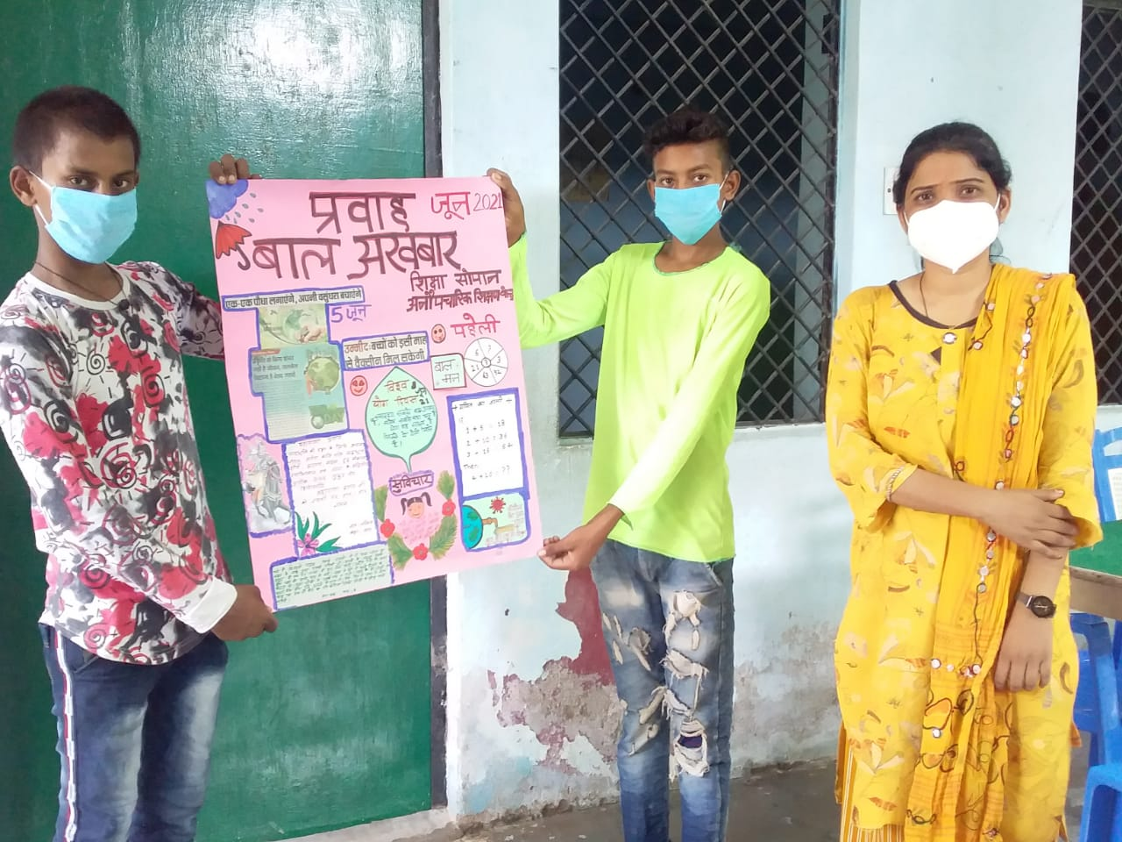
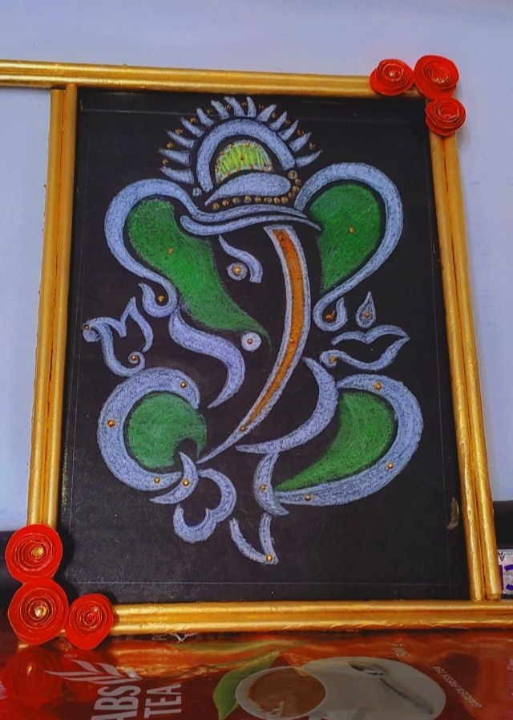
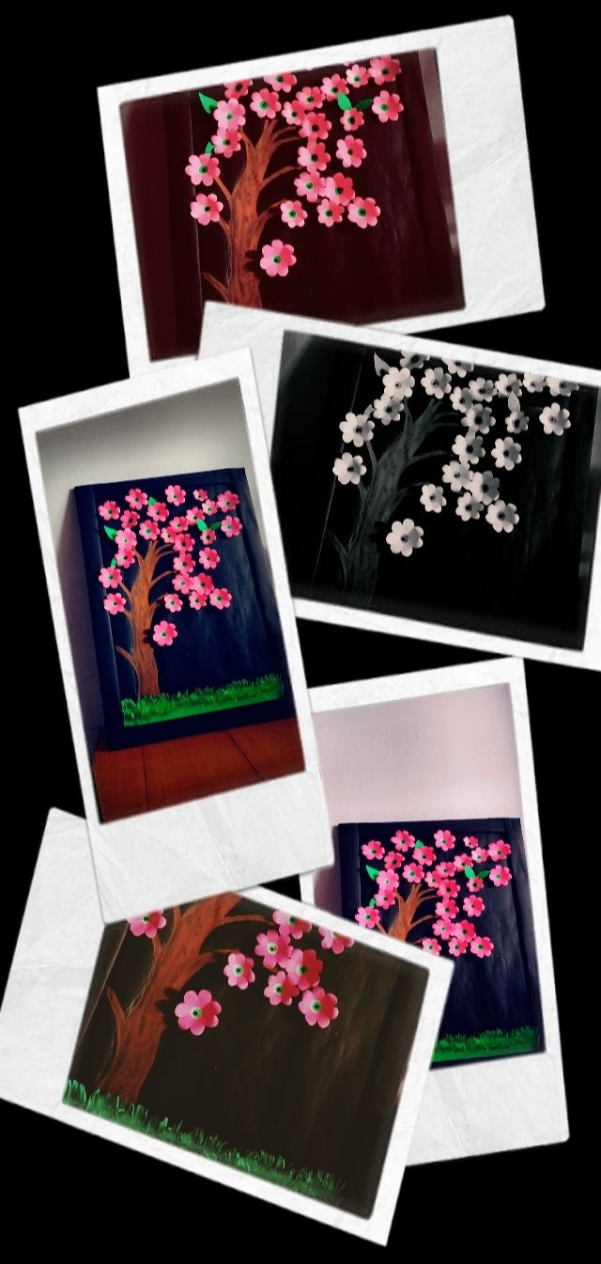
International Yoga Day
As we know that practicing Yoga is very important for our lives. If we won't make ourselves self-healthy and fit then we need to do exercise and yoga on a regular basis. To promote Yoga, the whole world celebrates International Yoga day on 21st June of every year. SASK also did the same. SASK celebrated this in community class by making sure of Covid protocol. The coordinator and volunteers of SASK taught the children about different-different Yoga and Pranayama. They also told the importance of Yoga in our life
Baal Akhbaar
In June the next edition of Baal Akhbaar was prepared by Saurabh of class 6th and Ajeet of class 7th. In this edition, Akhbaar was included the information regarding World Environment Day, About Vaccine for kids. Lalit of class 7th wrote the sentence on Maharana Pratap on the occasion of his birthday. Shreya of class 5th wrote a story on Onion and Shraddha of class narrate a poem on “Daughters”
Barasirohi Evening center(BEC)
World Environment Day
On 5th June, BEC celebrated World Environmental Day with full of dedication. This program was conducted through online mode due to Covid effect. In this program volunteers of BEC asked the students to do plantation on barren land at near by places and take care of those plant regularly. BEC coordinator spoke on the crisis of Oxygen during the second wave of Covid 19. Apart of it volunteers also advised to the children to spread awareness about importance of healthy and clean environment in our life. Pushpendra Ji, coordinator of BEC told to children that which plant should be planted and which plant is more beneficial for us like Neem, Tulsi, Peepal etc.
Craft Classes
BEC always focuses to develop skills among the children that’s why BEC always do various activities for enhancing the same. In the June month BEC conducted craft Classes for the students. Various activities like stone painting, paper cut painting, duck making etc. were done.

Slide 7
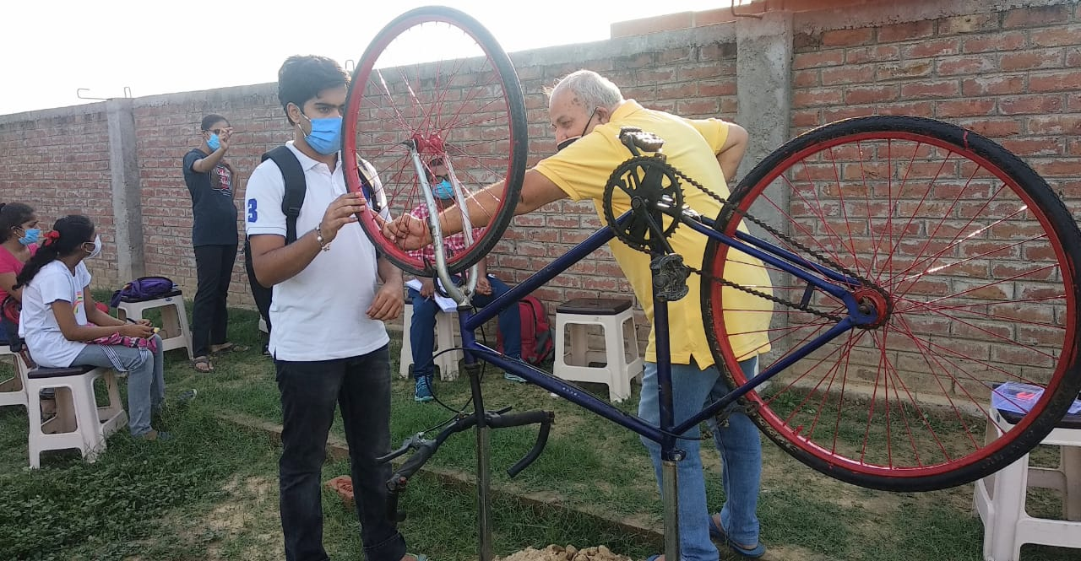
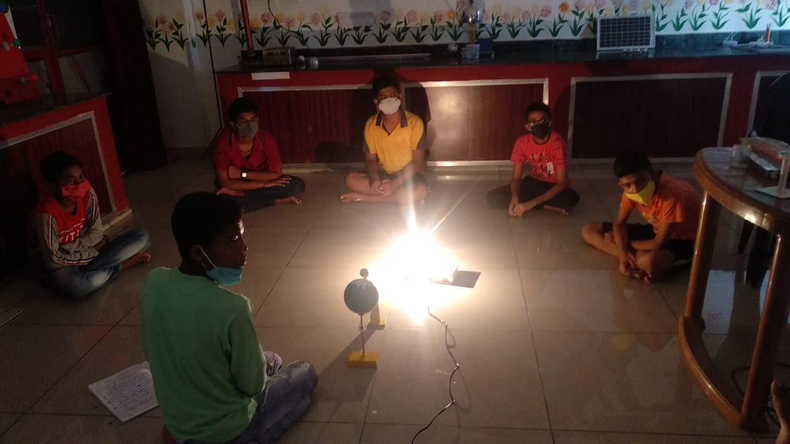
Educational work done in June month
In June month, BEC focused on various subjects of study. These works done in both ways online and offline. The subjects which were more focused were Science, English and Current affairs. Although the classes were running in online mode due to Covid but there were some students who found problem in study online due to unavailability of device. Those students were called by Geeta ji (Coordinator BEC) at her home for teaching with proper social distancing and Covid protocol.
Attraction of BEC children towards a You tube channel
“Vigyan Ke Prayog”
There is a you tube channels which is running by one of our dedicated volunteer Mr. Amit Kumar Bajpai. This channel includes various videos related to science experiment. BEC children visited regularly on this channel and watch the videos. This video’s helped them to understand the science in fruitful manner.
Sopan Ashram Evening center(SAEC)
In June month, SAEC did many activities to give benefits to the children. On 12th June SAEC conducted a workshop “Calculation from Cycle”. This workshop was held in the presence of Dr. H.C. Verma Sir & Mr. Amit Kumar Bajpai Ji. This session was based on mathematics, in which participants got to learn how to find the radius of a circle by using different-different methods, and many activities were done in this workshop.
Other than this workshop, one of the SAEC children Master Alok Kumar prepared a model with the help of Science cell volunteer Mr. Yogesh Jha. This model was based on the Solar system by which one can explain the solar eclipse and lunar eclipse with the help of this model.
Sopan Library
T

Slide 8
Science Cell
In this month
अंधकार को क्यों धिक्कारें, अच्छा हैं एक दीप जलायें
Web site : For more details please visit www.shiksha-sopan.org
How to donate: Shiksha Sopan
(b) You can write cheques/draft for donations in the name of “Shiksha Sopan” payble at Kanpur and send to the address given below.
(c) Online transfer can be made in State Bank of India, IITKanpur branch. Account No. 10426002488 , Account name “Shiksha Sopan”, IFSC code SBIN0001161
(d). People in US can use the link http://www.iitk.ac.in/dora/donation/PayPal/
and Choose Shiksha Sopan Charitable Contribution to donate through IIT Kanpur foundation using credit cards. All donations are 100% tax deductible in the United States. IIT Kanpur Foundation (Tax ID: 94-3370645) is Tax Exempt under 501(c)(3) classification of IRS.
(e). All donations are Tax free (up to 50%) under section 80/G.
Email Contacts : hcverma@iitk.ac.in, samkhan@iitk.ac.in, sopanbajpai@gmail.com
sopaniitk02@gmail.com
Postal Contact : Dr. Sameer Khandekar, Dept of Mech. Engg., IIT Kanpur 208016
Dr H C Verma, Dept of Physics, IIT Kanpur, Kanpur 208016
Phone contacts : Mr. Amit 9506611484, Mr. Ranjan 9235905046

